Slide 1
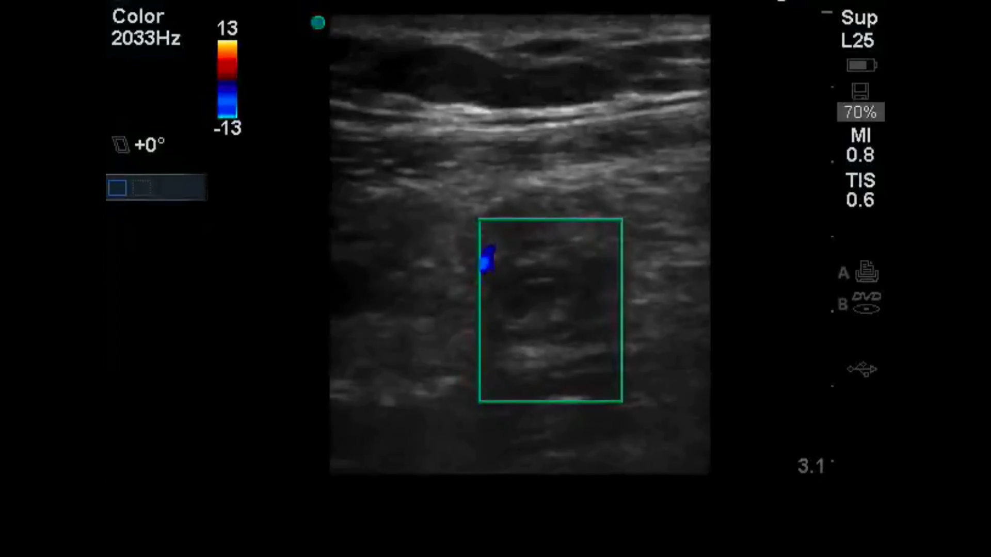
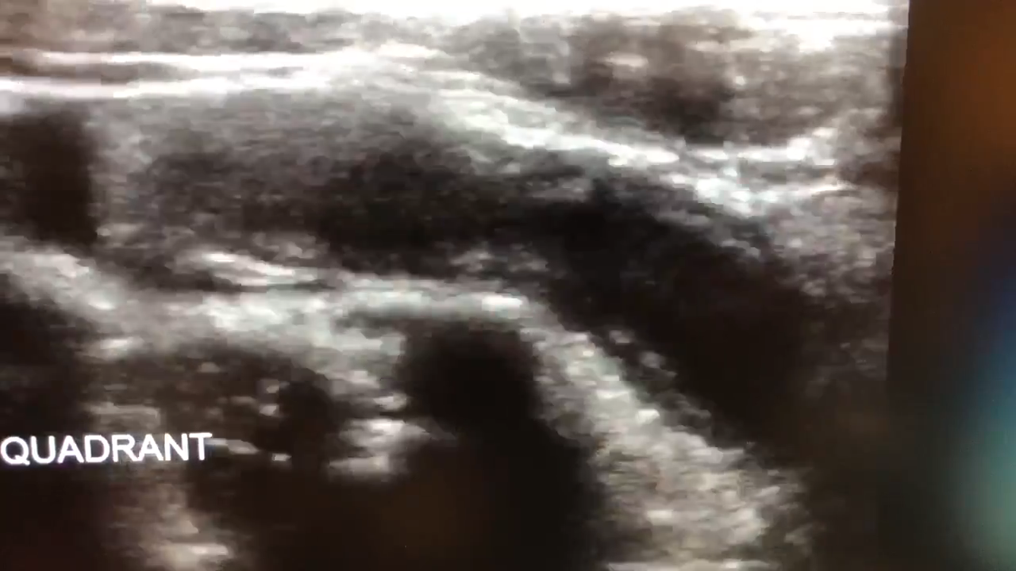
Appendicitis Point of Care Ultrasound

Slide 2
Outline
Indications and relative contraindications
Appendix anatomy including anatomical variants
Patient positioning and scanning technique
Clinical integration

Slide 3
The right patient for RLQ POCUS
Clinical concern for appendicitis (RLQ pain, fever, anorexia, nausea, vomiting)
Pain is thoughtfully managed
Immediate surgery is not a better option
You are not evaluating a large differential diagnosis (often the case in elderly pts)
Trying to avoid radiation exposure (young, pregnant, other)
No access to other imaging (CT/MRI)

Slide 4
The right patient for RLQ POCUS
Clinical concern for appendicitis (RLQ pain, fever, anorexia, nausea, vomiting)
Pain is thoughtfully managed
Immediate surgery is not a better option
You are not evaluating a large differential diagnosis (often the case in elderly pts)
Trying to avoid radiation exposure (young, pregnant, other)
No access to other imaging (CT/MRI)

Slide 5
The right patient for RLQ POCUS
Clinical concern for appendicitis (RLQ pain, fever, anorexia, nausea, vomiting)
Pain is thoughtfully managed
Immediate surgery is not a better option
You are not evaluating a large differential diagnosis (often the case in elderly pts)
Trying to avoid radiation exposure (young, pregnant, other)
No access to other imaging (CT/MRI)
=
Pediatrics
Young adults
Pregnant patients
Many others! Consider each case.

Slide 6
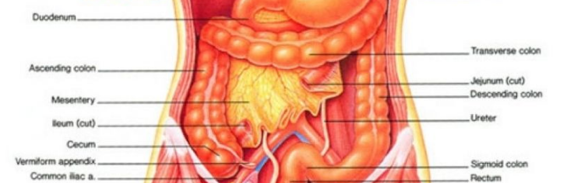
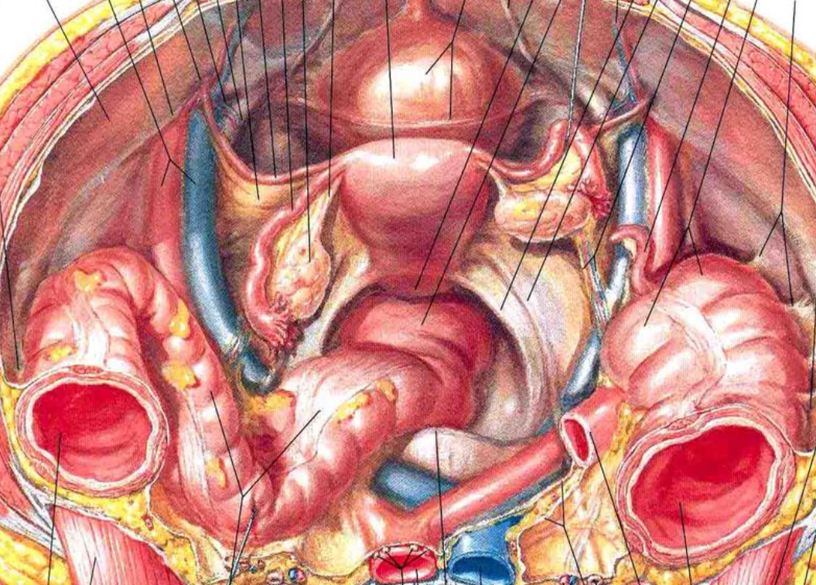
Appendix Anatomy
Cecum
Appendix
Iliac A.
The appendix is located in the RLQ originating from the cecum
Commonly found overlying the iliac artery/vein

Slide 7
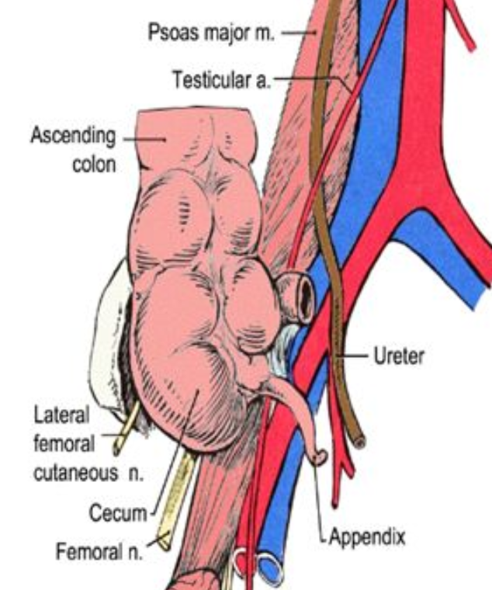
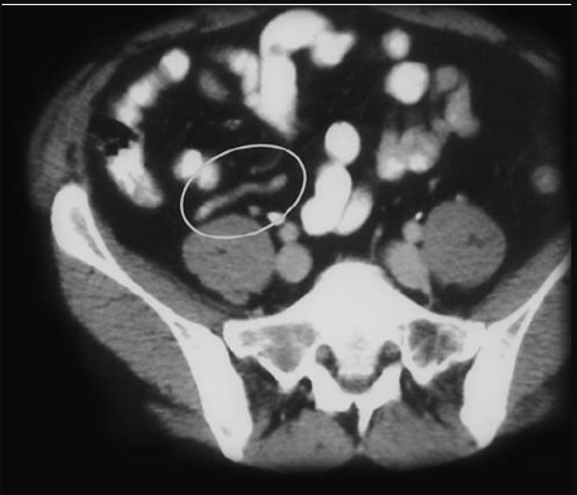
Appendix Anatomy
The appendix is located in the RLQ originating from the cecum
Commonly found overlying the iliac artery/vein AND psoas muscle

Slide 8
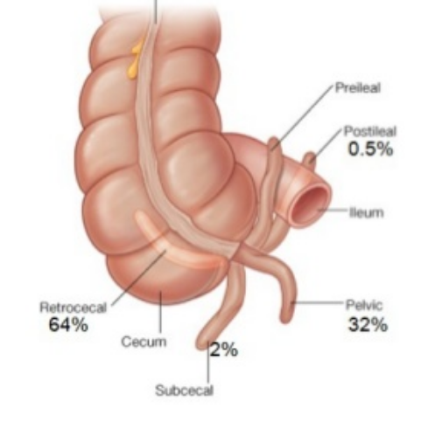
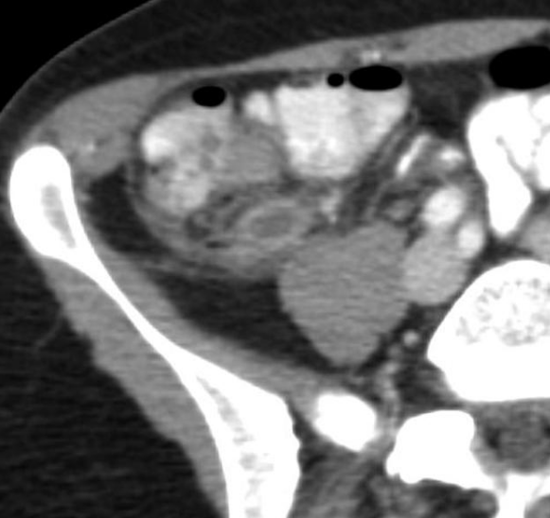
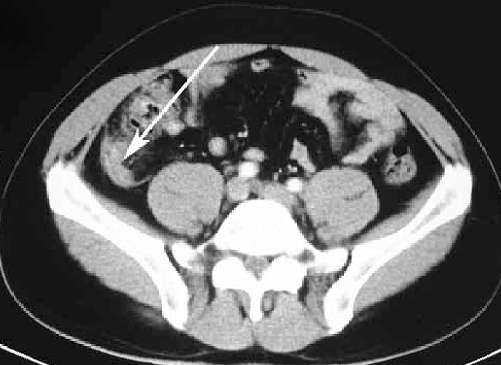
Appendix Anatomy Variants…
The appendix is actually only above the iliacs about 1/3 of the time
More likely, it is found behind the cecum, where there less well defined landmarks

Slide 9
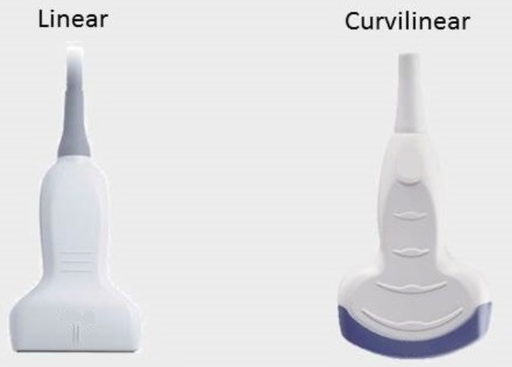
Probe Selection
Linear is good for image resolution
Curvilinear is good for tissue penetration

Slide 10
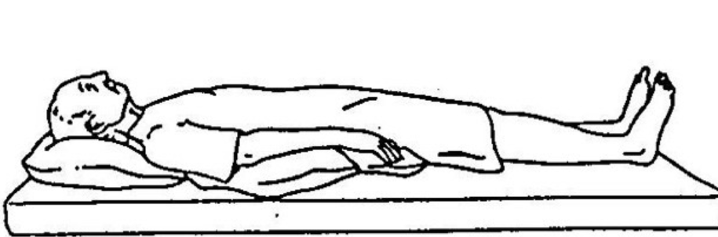
Patient Positioning
Scanning is done in the supine position
If tolerable, crossing the patient’s right leg over the left may help bring appendix more anterior

Slide 11
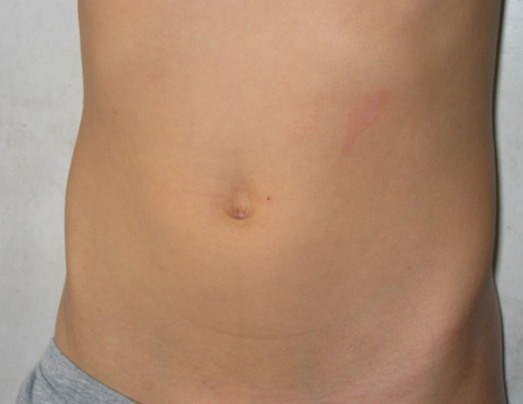
Scanning technique: point of most pain
Have the patient point to the location of most intense pain and put the probe there
Transverse view -> indicator to patient’s right
Sagittal -> indicator to patient’s head

Slide 12
Scanning technique: systematic
Search systematically for the appendix or landmarks
Appendix should be bounded by:
Iliac crest (lateral)
Iliac a/v (medial)
Psoas (posterior)
Keep the indicator up or to the right

Slide 13
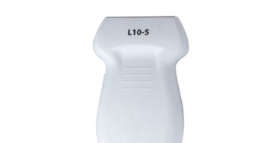
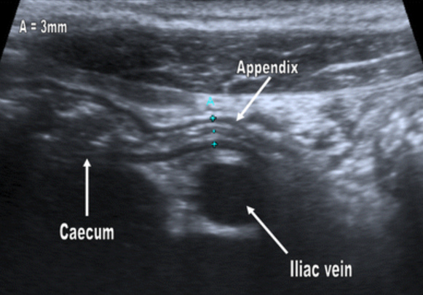
Ultrasound findings in normal appendix
Tubular structure (<6 mm diameter)
Compressible
Non-peristaltic
Proximal portion originates from the cecum

Slide 14
Ultrasound findings in normal appendix

Slide 15
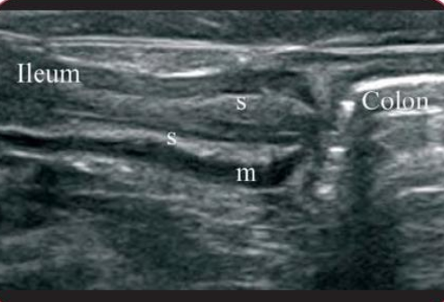
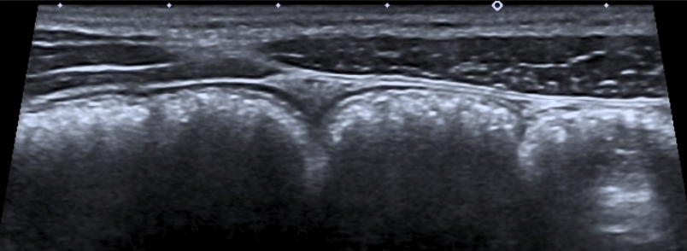
Ultrasound findings in normal appendix
VS Small bowel
Peristalsing with luminal contents
VS Large bowel (cecum)
Large stx with “dirty air pattern”

Slide 16
Ultrasound signs of acute appendicitis
Primary Criteria
Non-compressibility
Diameter >6 mm

Slide 17
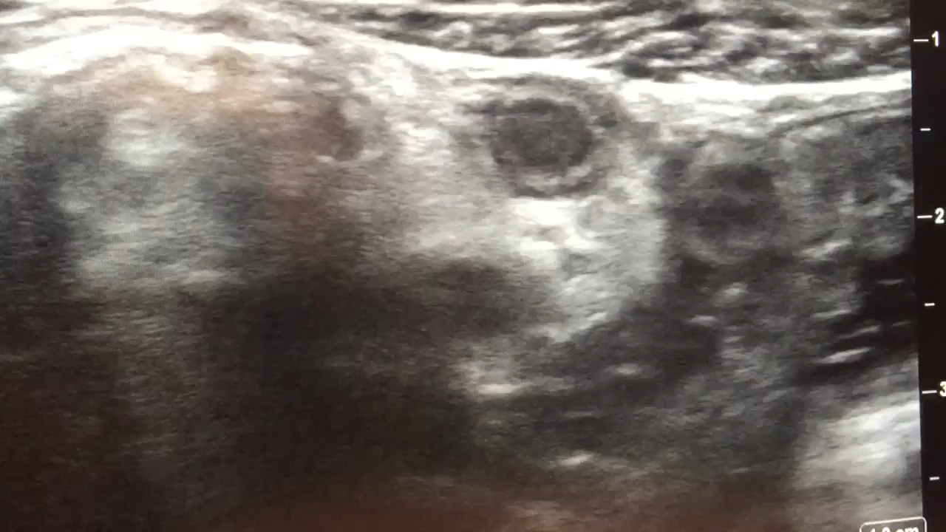
Ultrasound signs of acute appendicitis
Primary Criteria
Non-compressibility
Diameter >6 mm

Slide 18
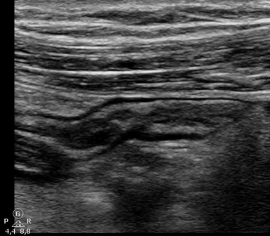
Ultrasound signs of acute appendicitis
Primary Criteria
Non-compressibility
Diameter >6 mm

Slide 19
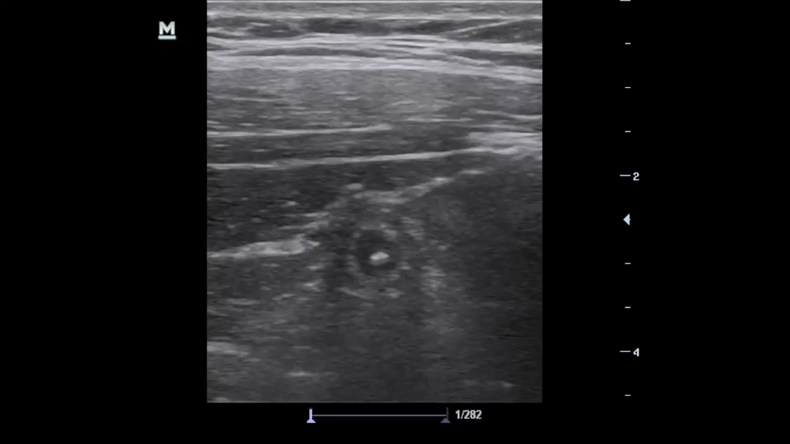
Ultrasound signs of acute appendicitis
Primary Criteria
Non-compressibility
Diameter >6 mm

Slide 20
Ultrasound signs of acute appendicitis
Primary Criteria
Non-compressibility
Diameter >6 mm
Secondary Signs
Appendicolith – hyperechoic with posterior shadowing
Free fluid surrounding appendix
Mural hyperemia on color Doppler
Hyperechoic local mesenteric fat
Target sign
Hypoechoic fluid
Hyperechoic mucosa/submucosa
Hypoechoic muscularis

Slide 21
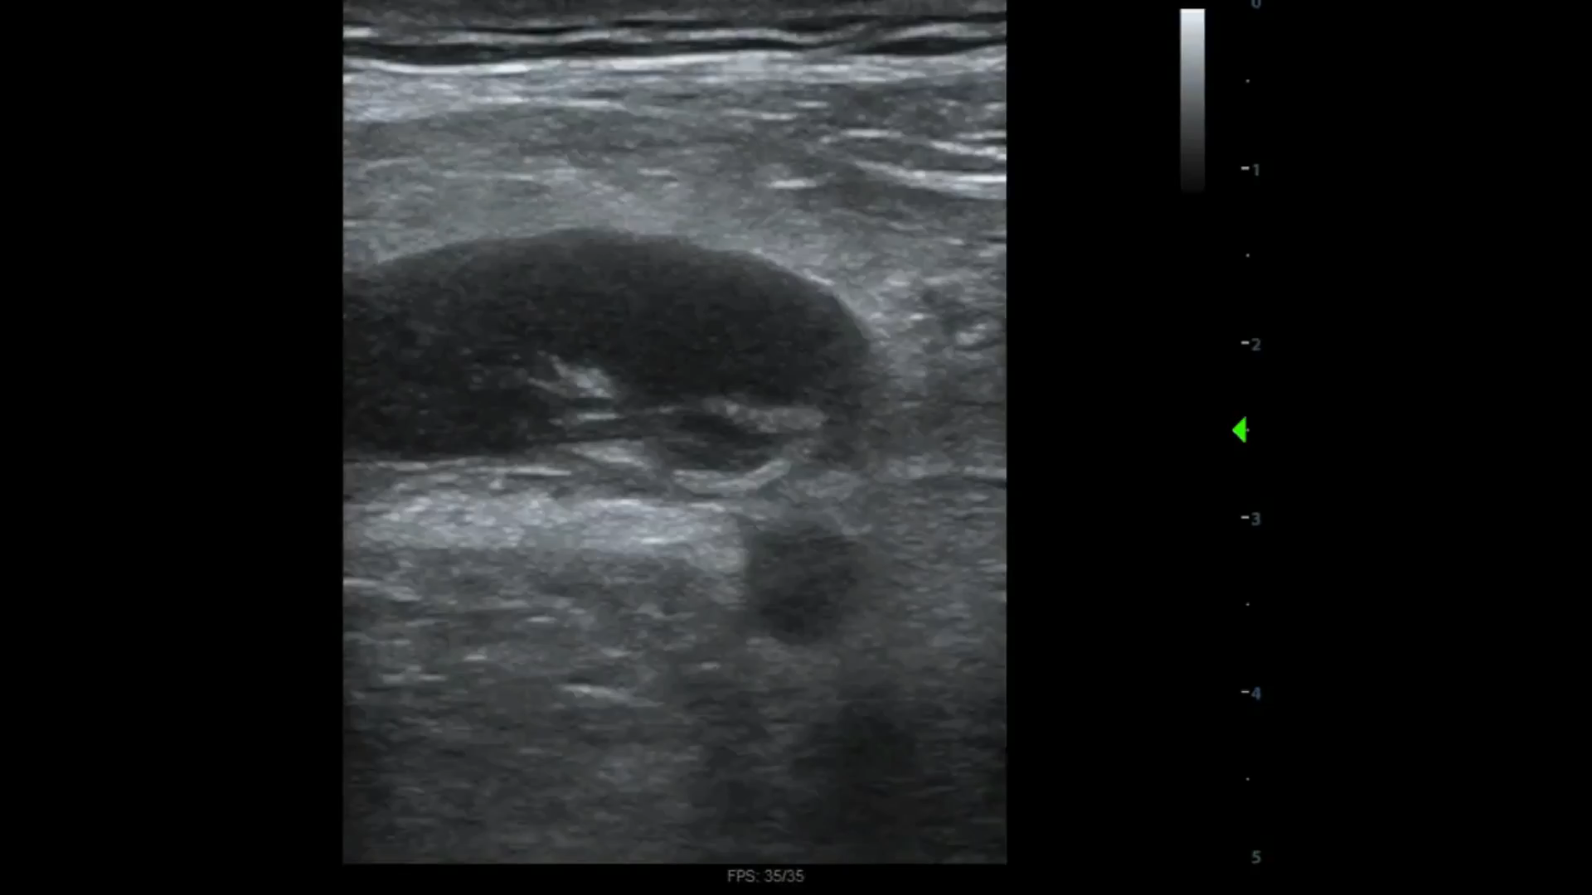
Acute appendicitis

Slide 22
Acute perforated appendicitis
Findings:
Free fluid surrounding non-compressible tubular structure which overlies the iliac artery and psoas muscle
Mural hyperemia on Doppler

Slide 23
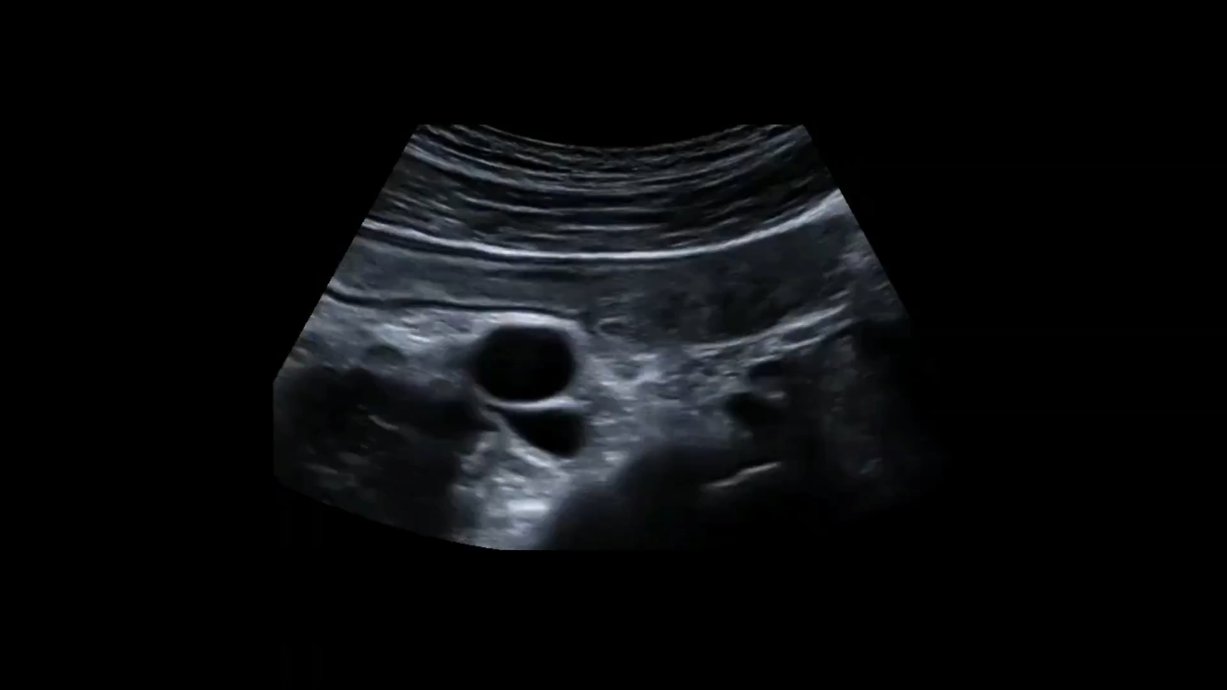
Acute Appendicitis
Findings: dilated blind ended tubular structure overlying iliac vessels and originating from the cecum with large fecolith

Slide 24
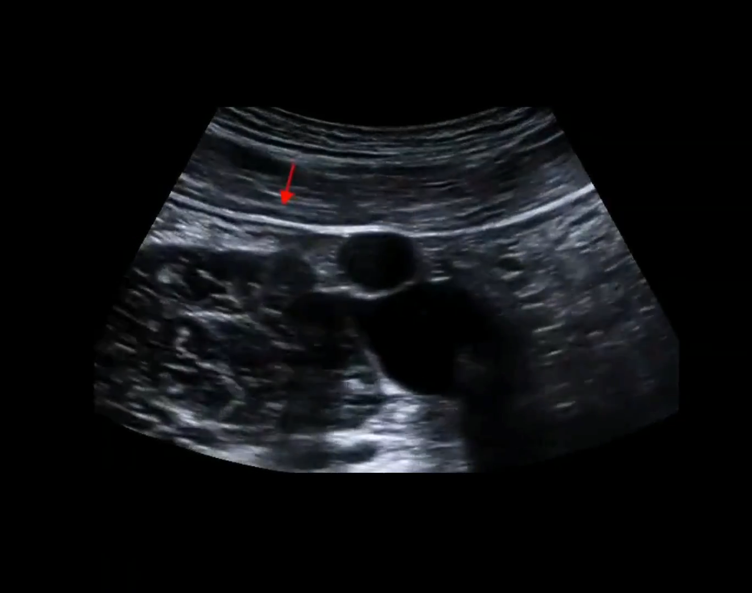
Acute Appendicitis
Iliac vessels
Psoas muscle

Slide 25
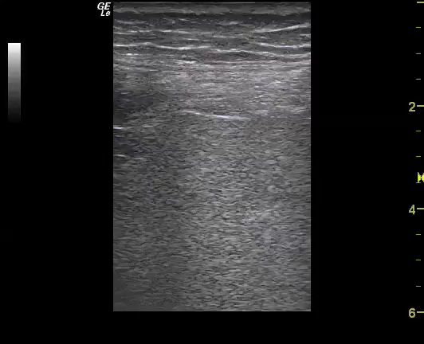
A-line pattern (abdomen)

Slide 26
A-line pattern (abdomen)
Prominent A-line pattern in abdomen suggests intraabdominal free air

Slide 27
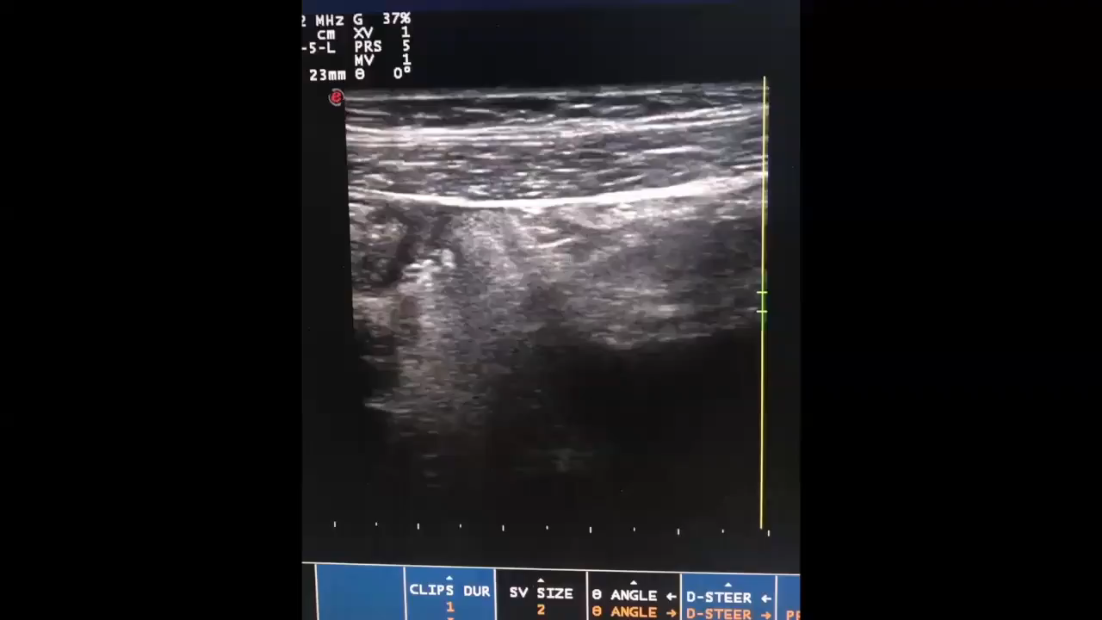
Acute Appendicitis
Findings: dilated blind ended tubular structure overlying iliac vessels with surrounding hyperechogenic fat

Slide 28
Interpreting Findings (when to CT)
Appendix Fully Visualized
High suspicion
Suspected
Low suspicion
Equivocal Findings
Appendix was not fully visualized and there are some secondary signs of appendicitis
Appendix NOT visualized
- Ongoing area of research
Likely does not need CT
Probably needs a CT
If few S/S: no CT
If many S/S: CT

Slide 29
Summary
Consider ultrasound as a first line diagnostic tool in select patients
Scan over point of most tenderness or systematically
Look for a blind ending, non-peristalsing, tubular structure
Non-compressibility and >6 mm width are diagnostic for appendicitis
Integrate test findings with overall clinical scenario

Slide 30
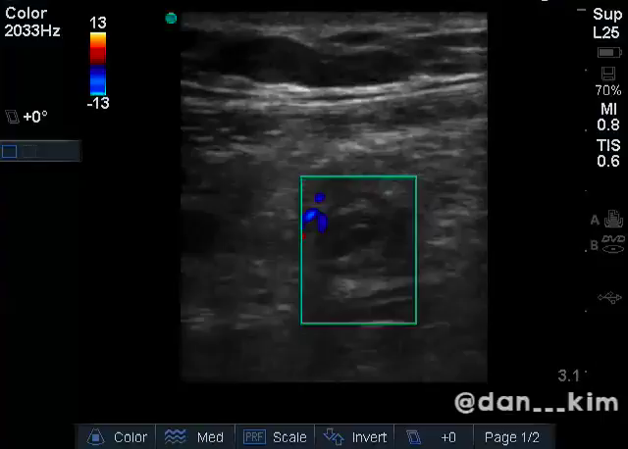
Acute Appendicitis
Findings: dilated tubular structure with hyperemia on Doppler
Target sign
Ring of fire sign

Slide 31
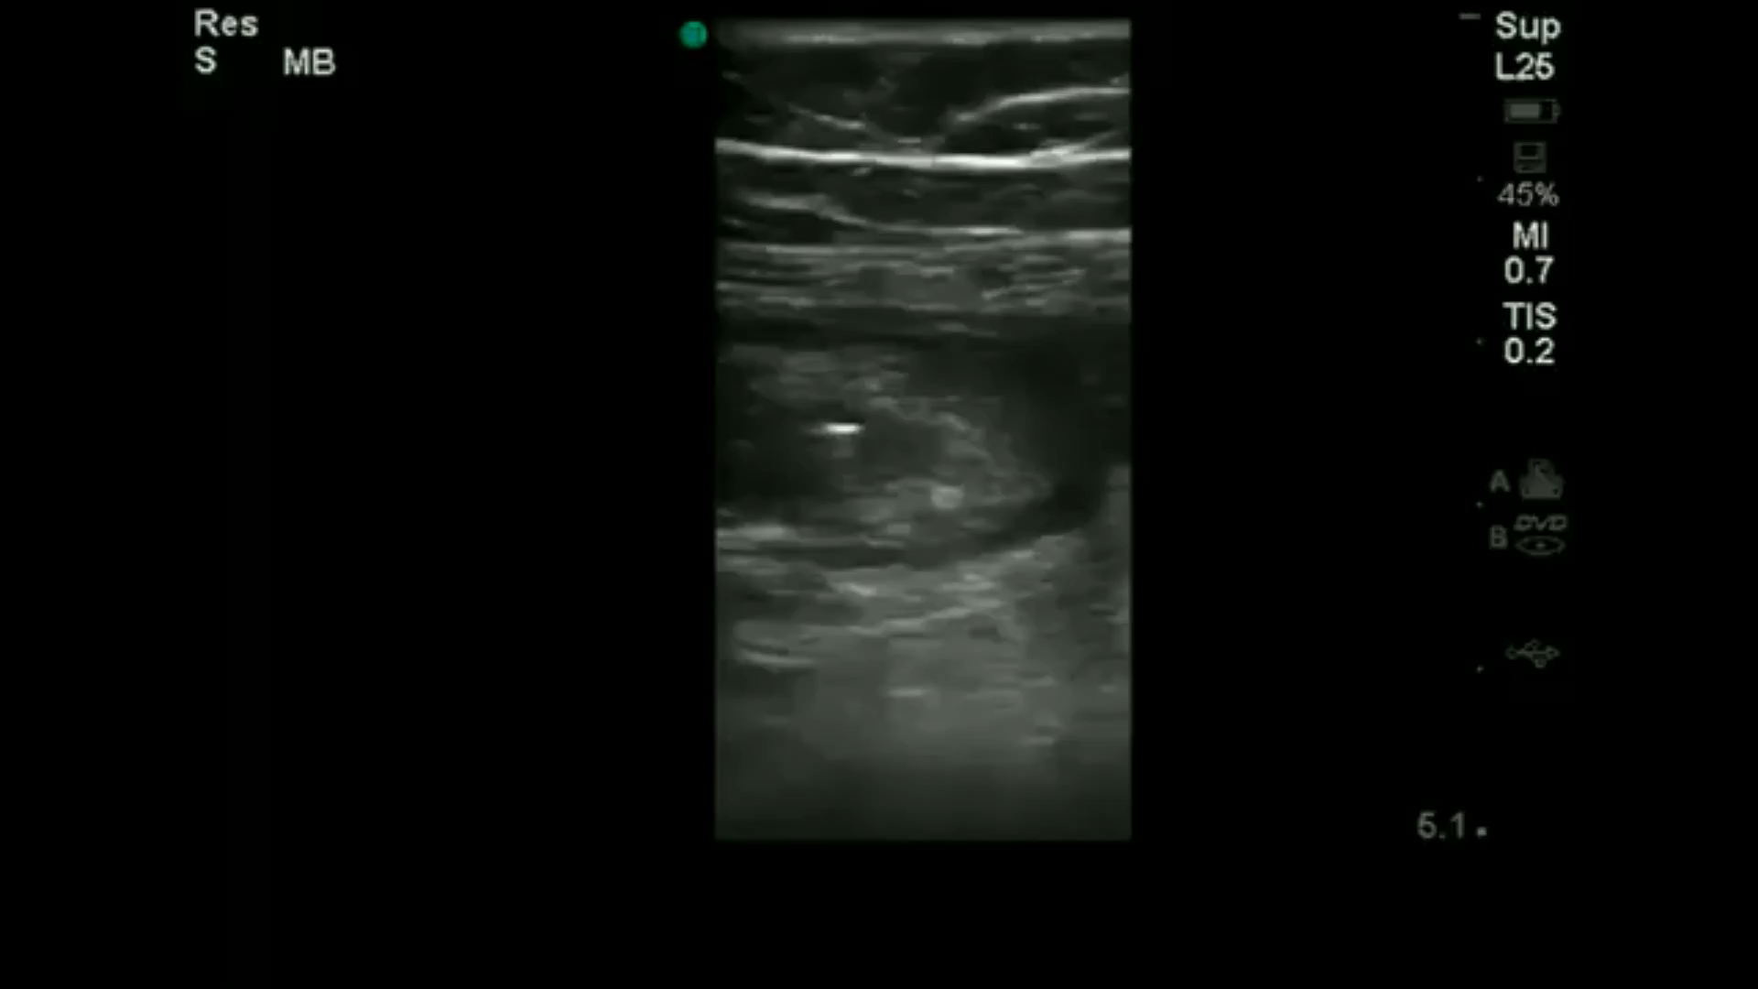
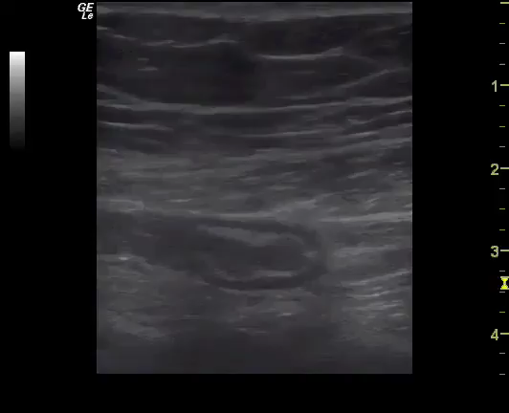
Acute Appendicitis
Findings: tip of appendix

